Slide 1
Natera Internship
Xinyi Zhang, MS Biostatistics and Data Science

Slide 2

Natera Overview
Founded in 2004
Biotechnology company
Global Leader in cell-free DNA (cfDNA) technology testing
Oncology (recurrence), Women Health (pre-natal exam), Organ Health (post-transplant rejection surveillance)
Notes:
Cell free DNA (cfDNA): as cell die, their DNA released into bloodstream before broken down. It is non-encapsulated DNA in the bloodstream. It is no longer in the nucleus, enter bloodstream during apoptosis or necrosis. When we take the blood, the cfDNA will be in the plasma

Slide 3
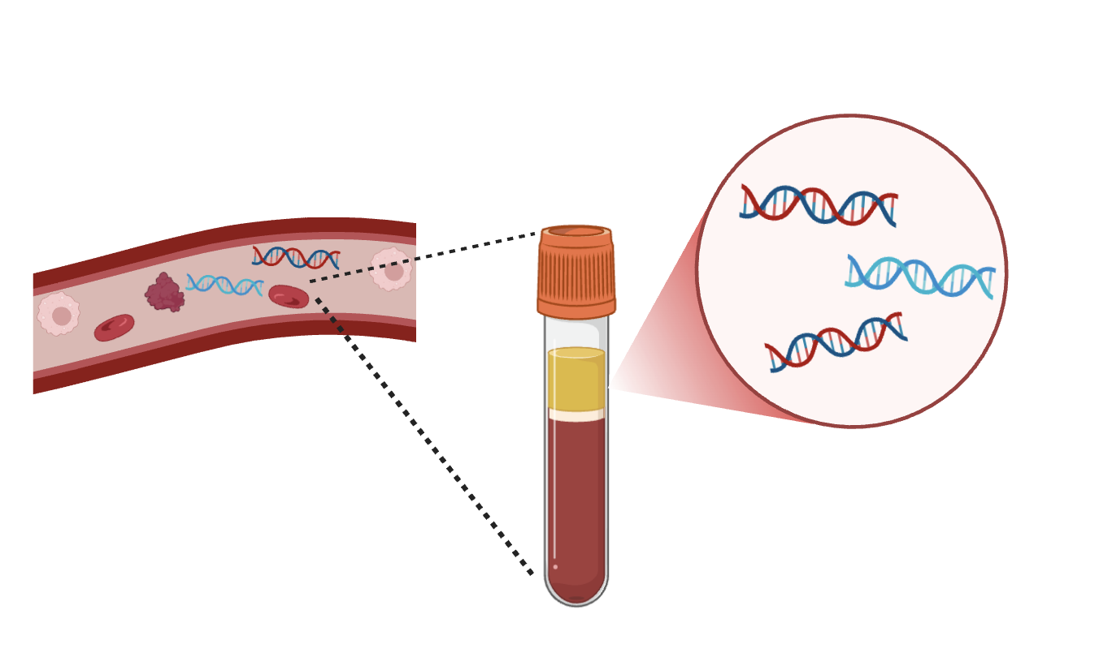
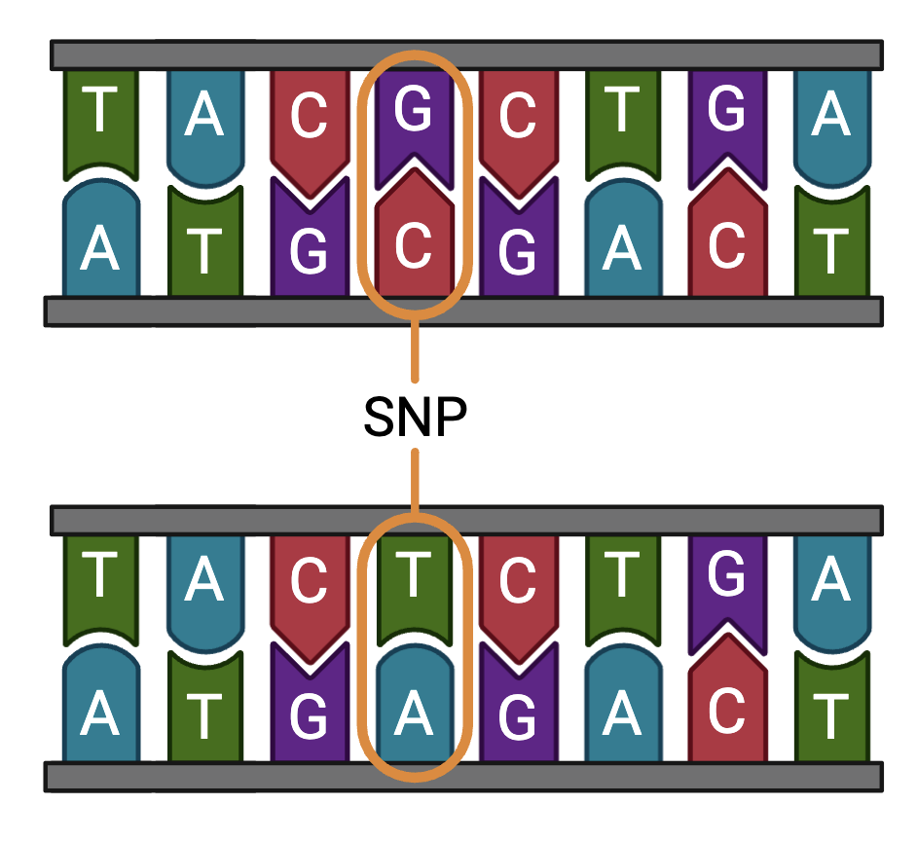
Mechanism behind the technology
Cell-free DNA (cfDNA)
Cell death shed DNA into bloodstream
Blood plasma
Organ Health: distinguish between donor & recipient?
Single Nucleotide Polymorphism (SNP)
Notes:
Cell free DNA (cfDNA): as cell die, their DNA released into bloodstream before broken down. It is non-encapsulated DNA in the bloodstream. It is no longer in the nucleus, enter bloodstream during apoptosis or necrosis. When we take the blood, the cfDNA will be in the plasma
Oncology: circulating tumour DNA (ctDNA), recurrent cancer, relapse
Single base variant

Slide 4
Molecular Biology Informatics & Statistics
MBIS
Molecular Biology
Biostatistics
Bioinformatics
Data Science
Research Infrastructure
Medical Affair
Data Management
Clinical Operation
Translational Medicine
Notes:
Research infrstructure is for software engineering
Molecular bio: develop assay

Slide 5
ACES-EMB clinical narrative
R ShinyApp Project

Slide 6
ACES-EMB clinical narrative
A Comparative Effectiveness Study in Heart Transplant Patients of Rejection Surveillance with Cell-free DNA versus Endo-myocardial Biopsy
Effectiveness of rejection surveillance of Prospera
Prospera: transplant rejection assessment by blood draw
Randomized Clinical Trial
Site level
dd-cfDNA blood draw (Prospera) or Endomyocardial Biopsy
Clinical narrative R ShinyApp
Visualization of critical events for individual patients
From enrollment to end of study
Basic analysis
All data presented in the ShinyApp are simulated data
Notes:
Objective: compare the effectiveness of rejection surveillance of heart transplant recipients with Prospera dd-cfDNA to rejection surveillance with endomyocardial biopsy (EMB) in the first post-transplant year.
R: The goal is to create a general visualization for events of importance along a patient’s timeline in the ACES trial from enrollment to EOS. Each event point can be referenced to the data, date, and details provided in the eCRF. This will help put together a clinical narrative for each patient as well as identify gaps in data at the patient to site levels.

Slide 7
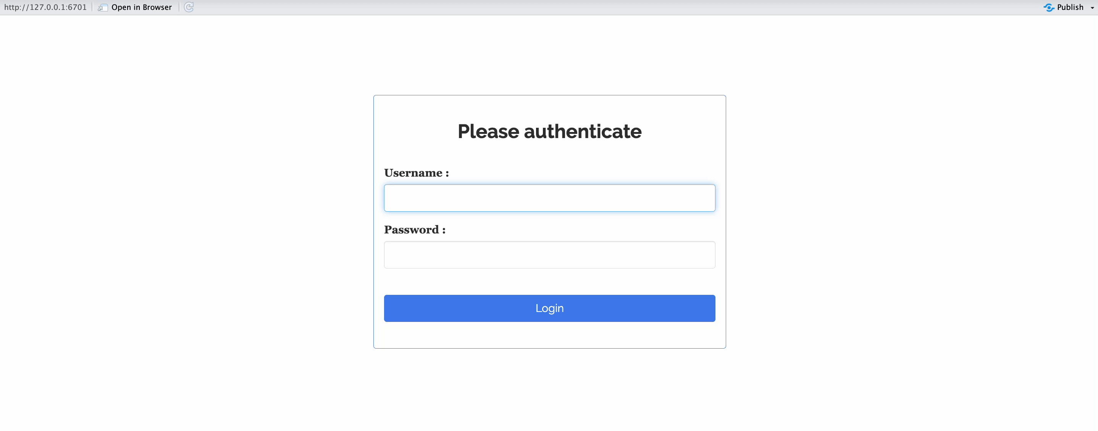
ACES-EMB clinical narrative
Login and Welcome Page
Password required
Welcome page

Slide 8
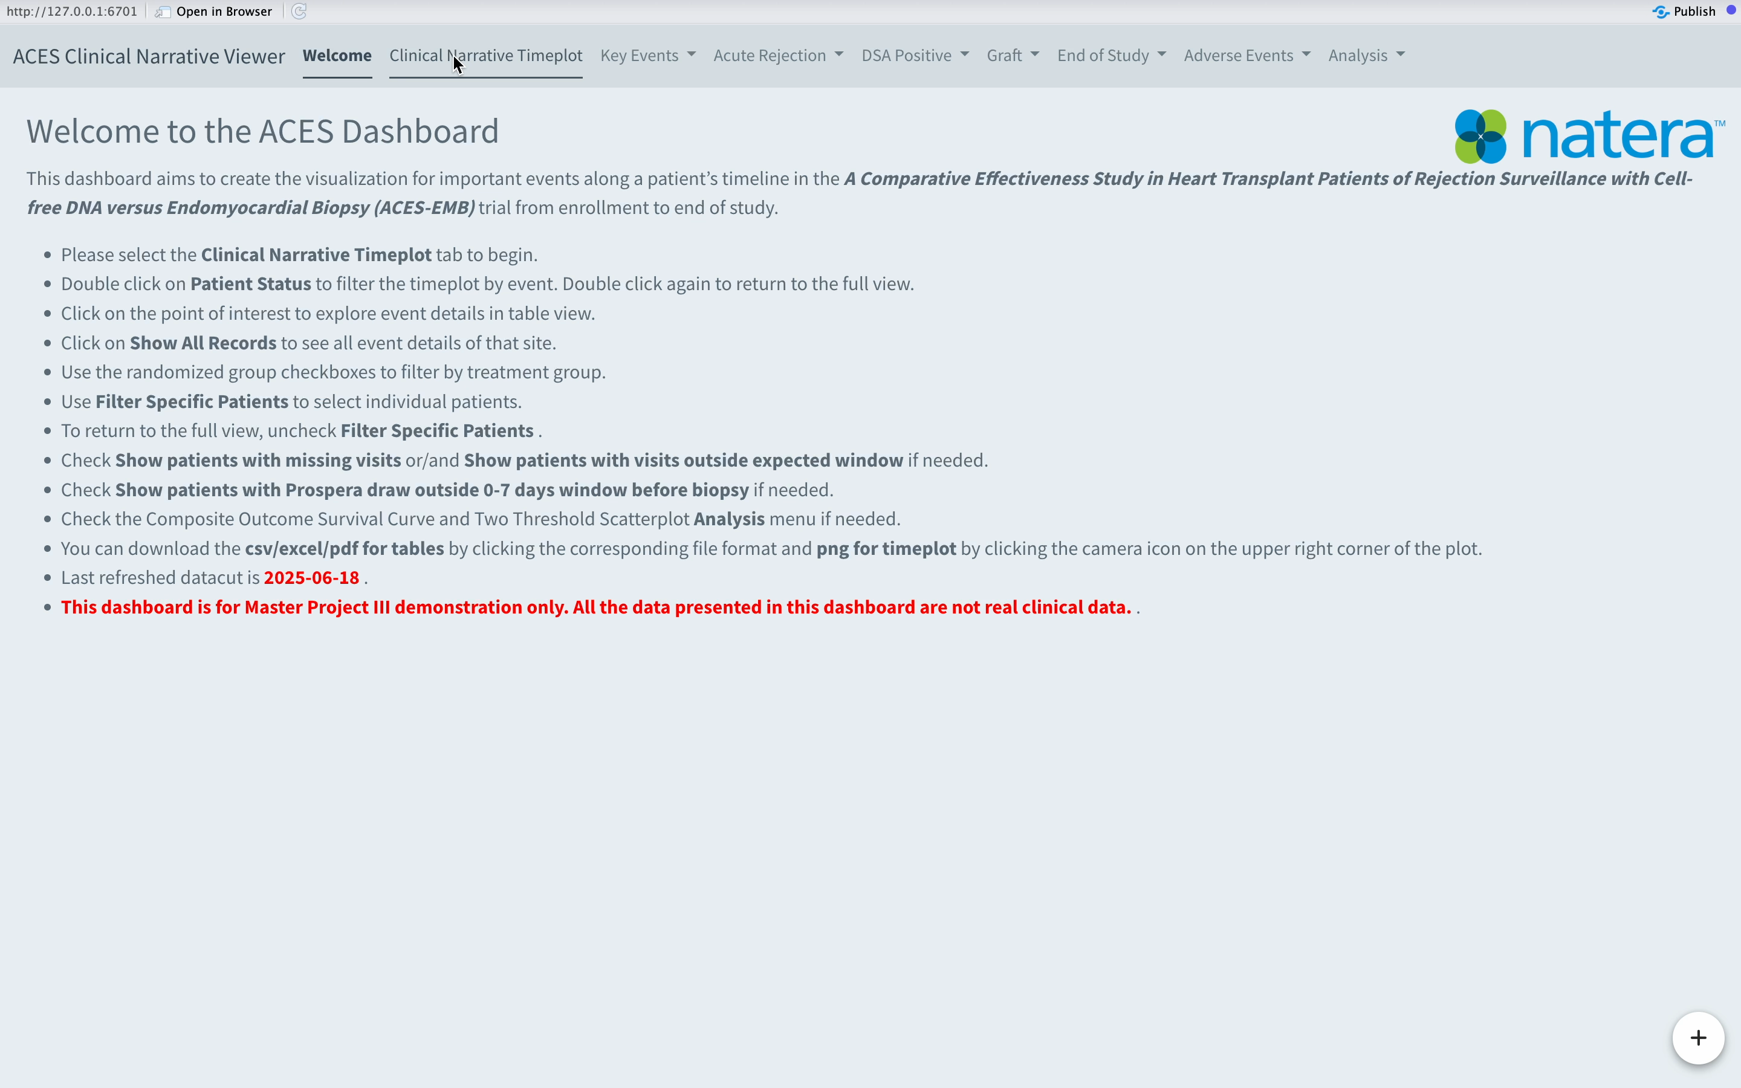
ACES-EMB clinical narrative
Clinical Narrative Timeplot
Site dropdown menu
Timeplot

Slide 9
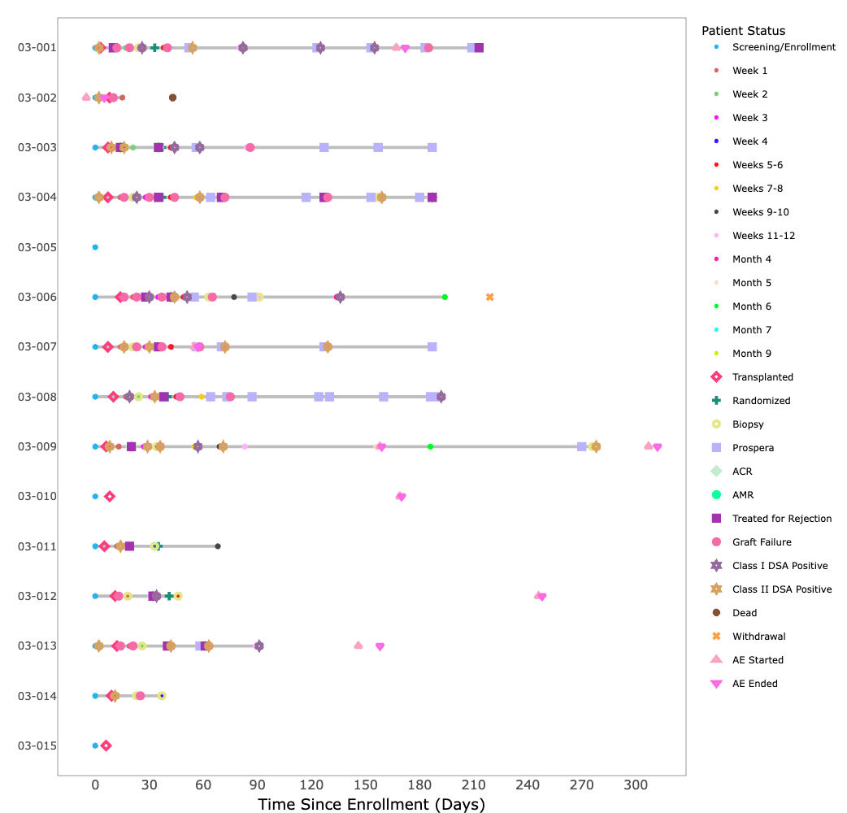
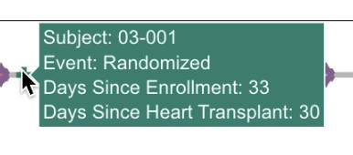
ACES-EMB clinical narrative
Clinical Narrative Timeplot
Patient IDs
Time Since Enrollment (Days)
Patient Status: critical events
Basic Information shown when hover the mouse

Slide 10
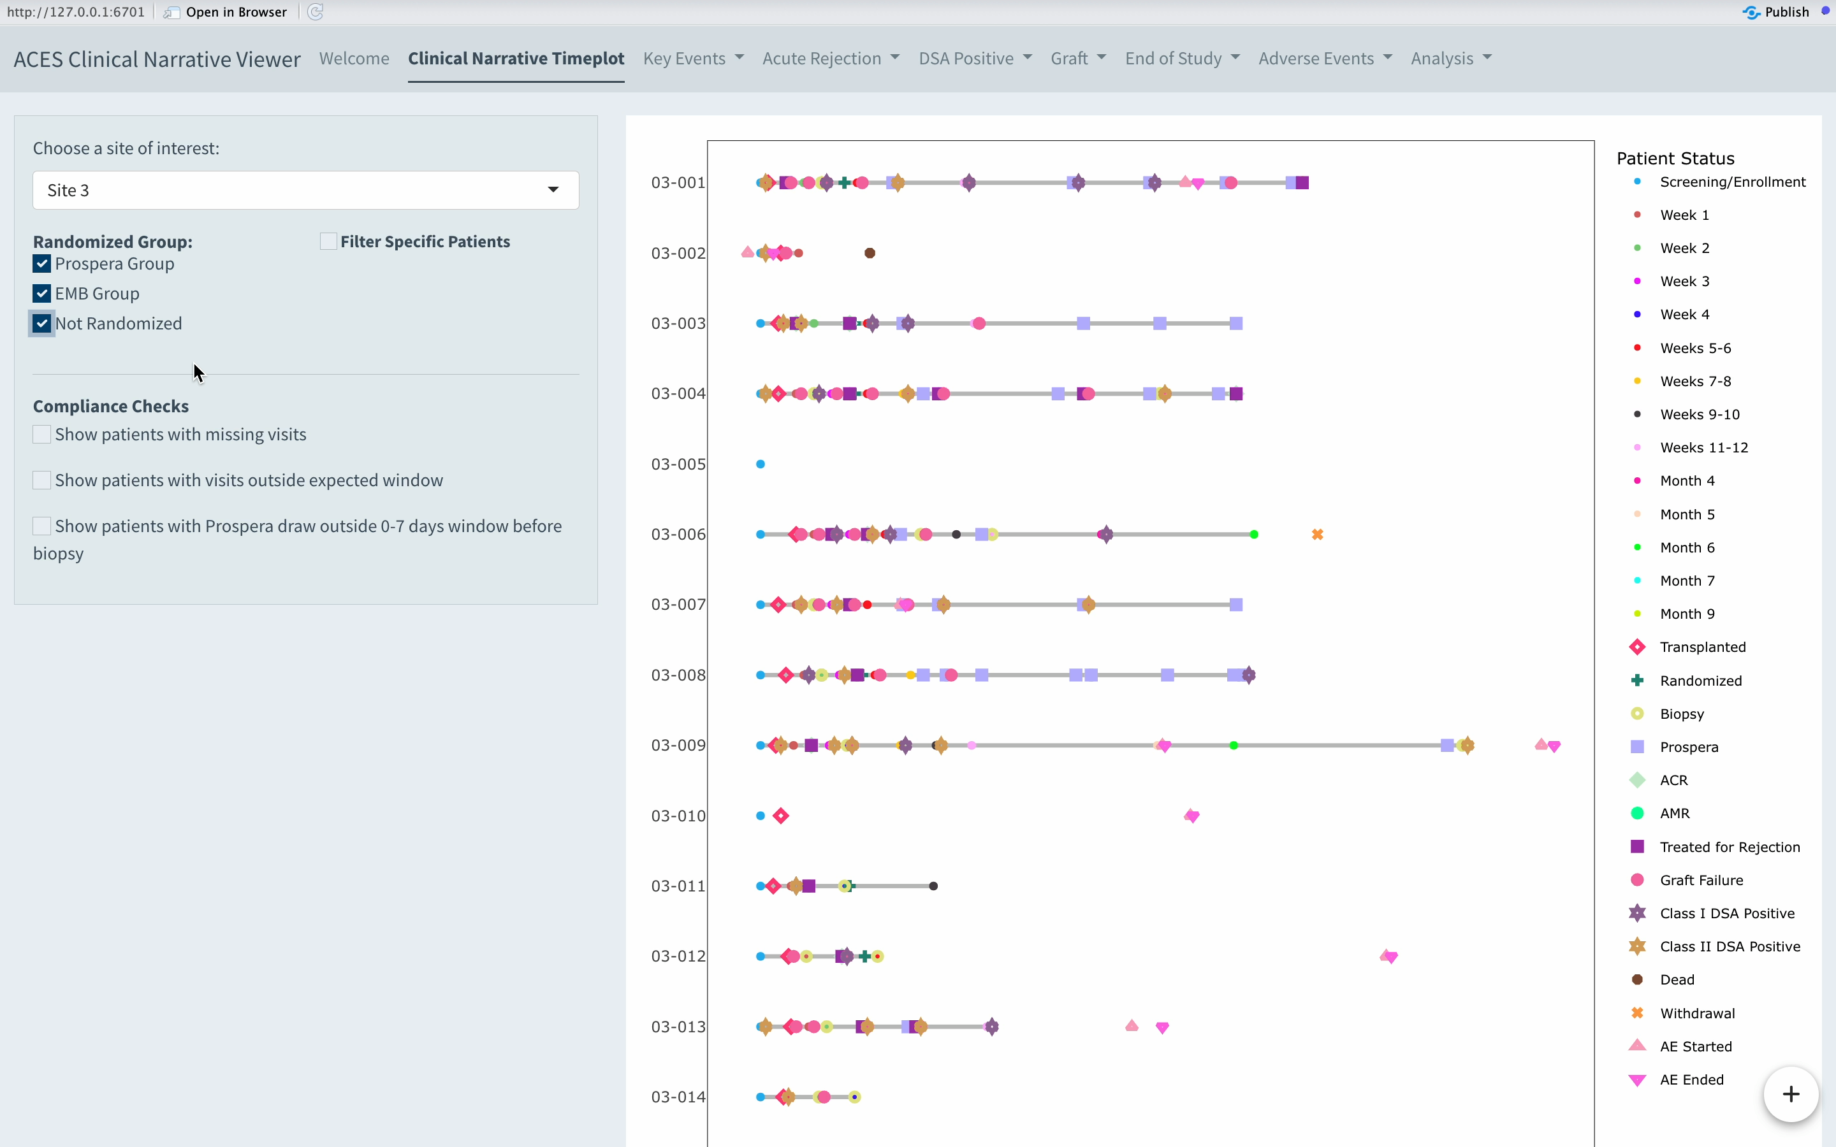
ACES-EMB clinical narrative
Clinical Narrative Timeplot
Randomized Group checkboxes

Slide 11
ACES-EMB clinical narrative
Clinical Narrative Timeplot
Randomized Group checkboxes

Slide 12
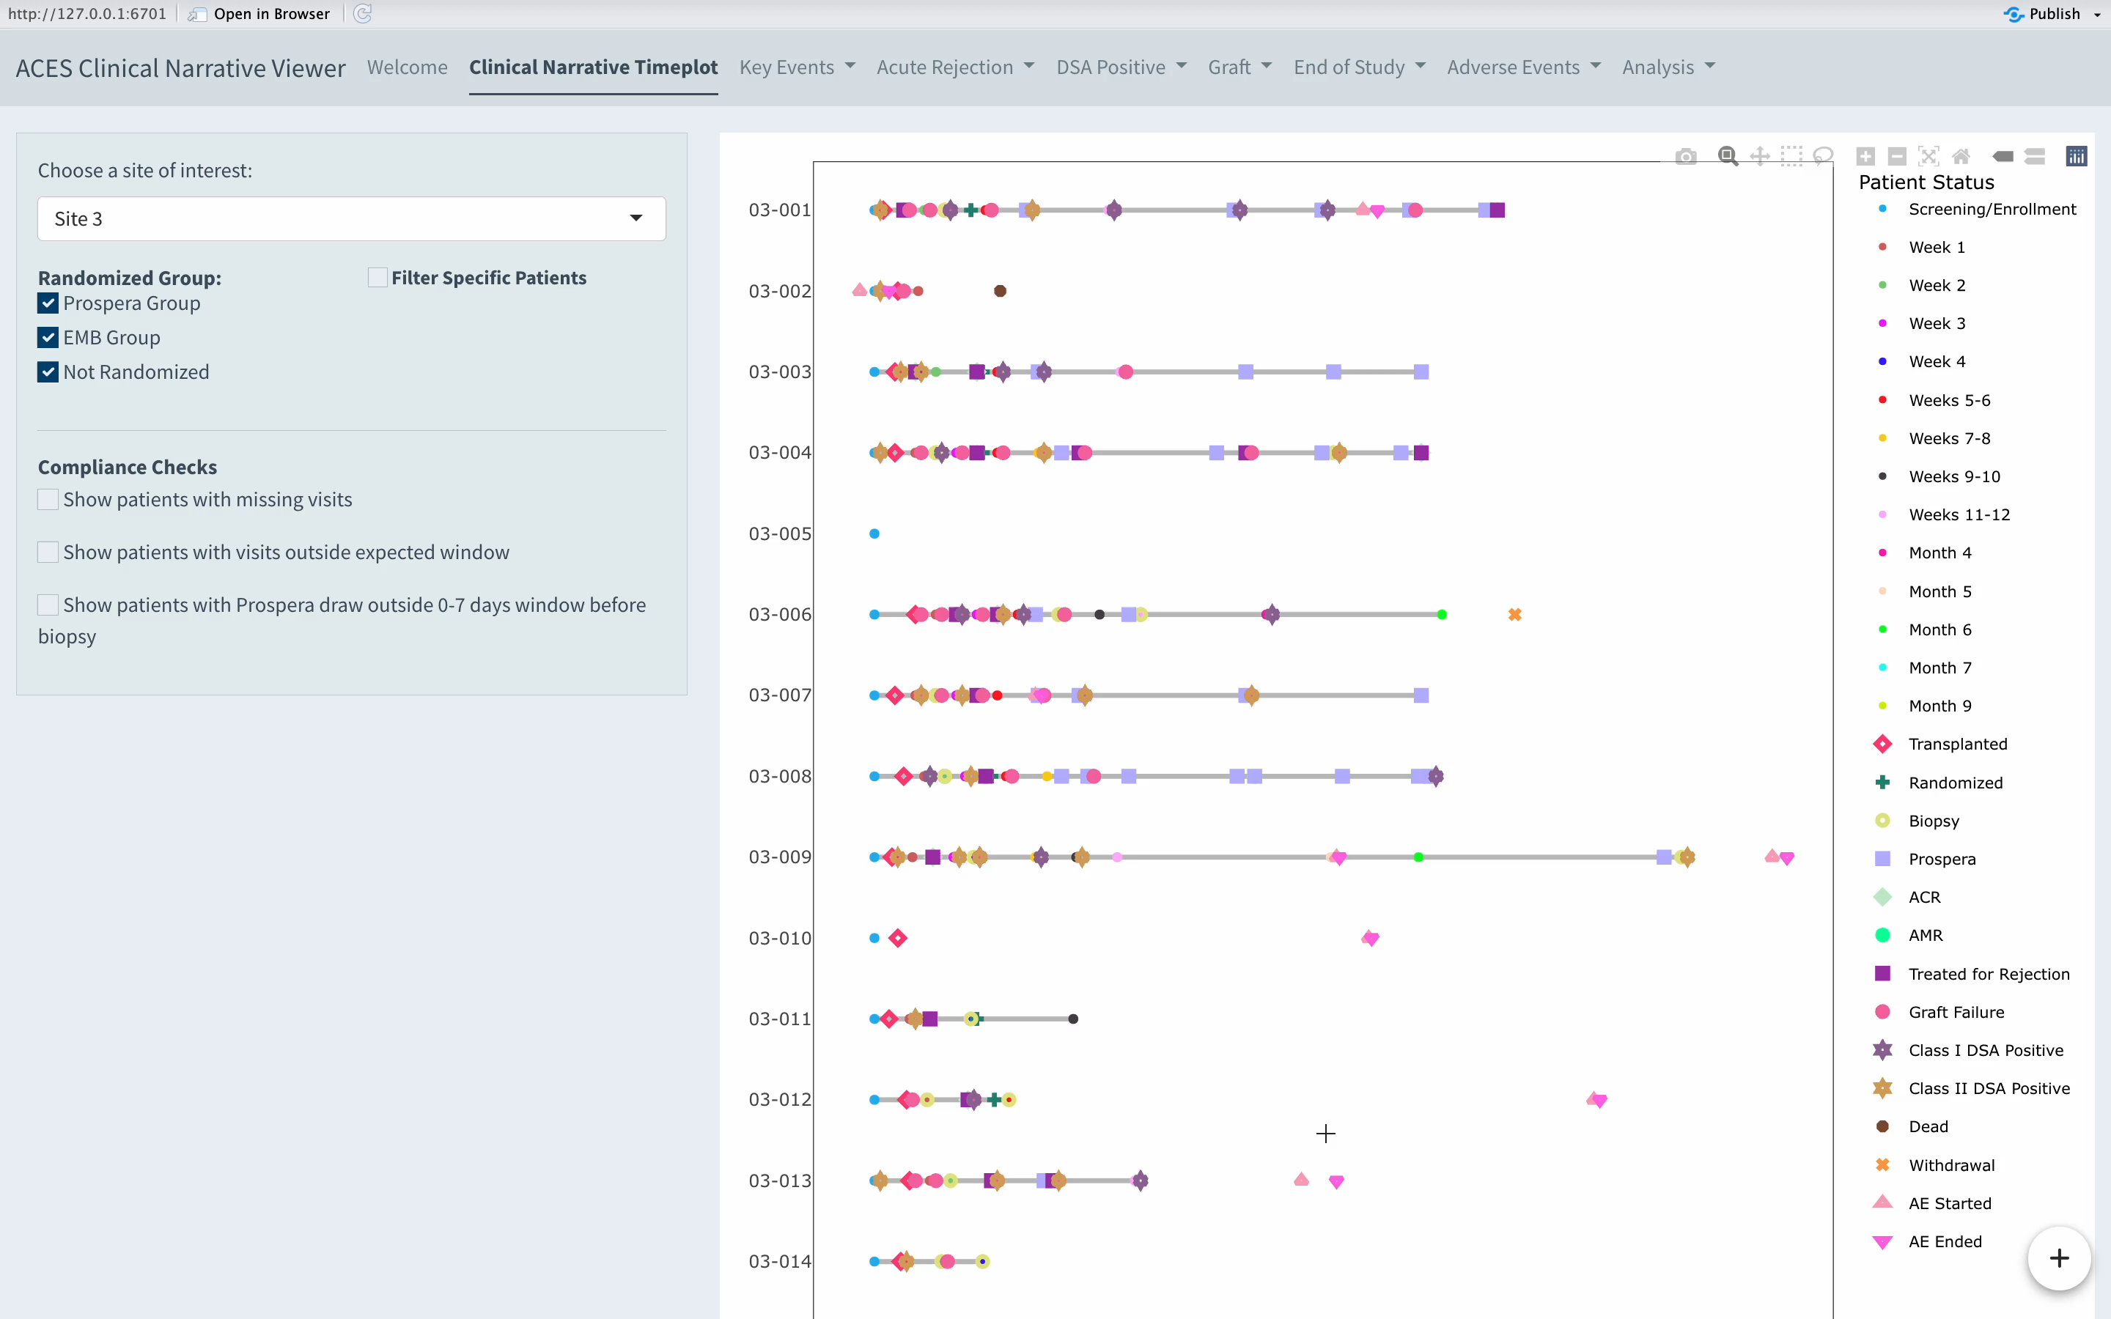
ACES-EMB clinical narrative
Clinical Narrative Timeplot
Filter Specific Patients

Slide 13
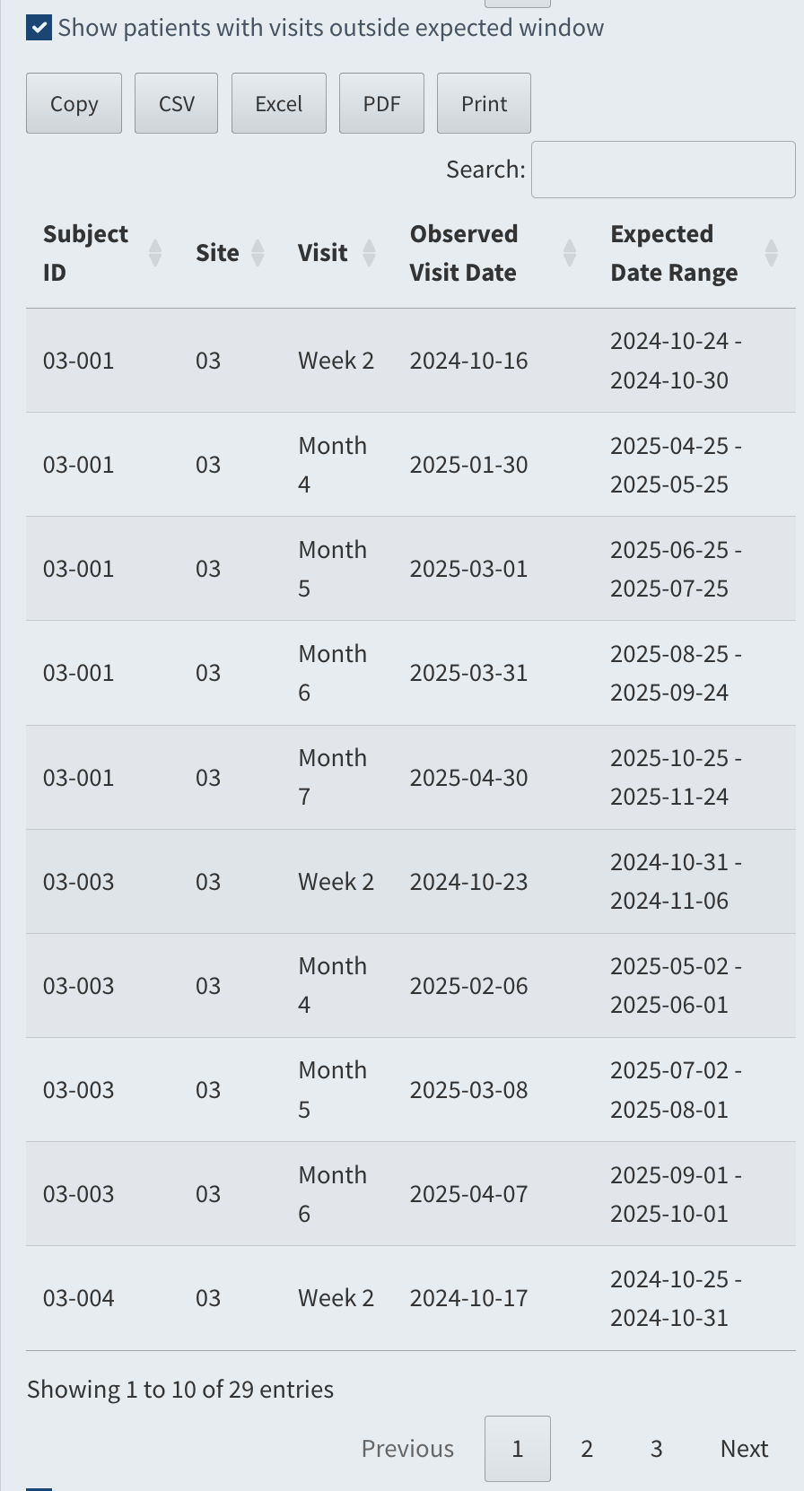
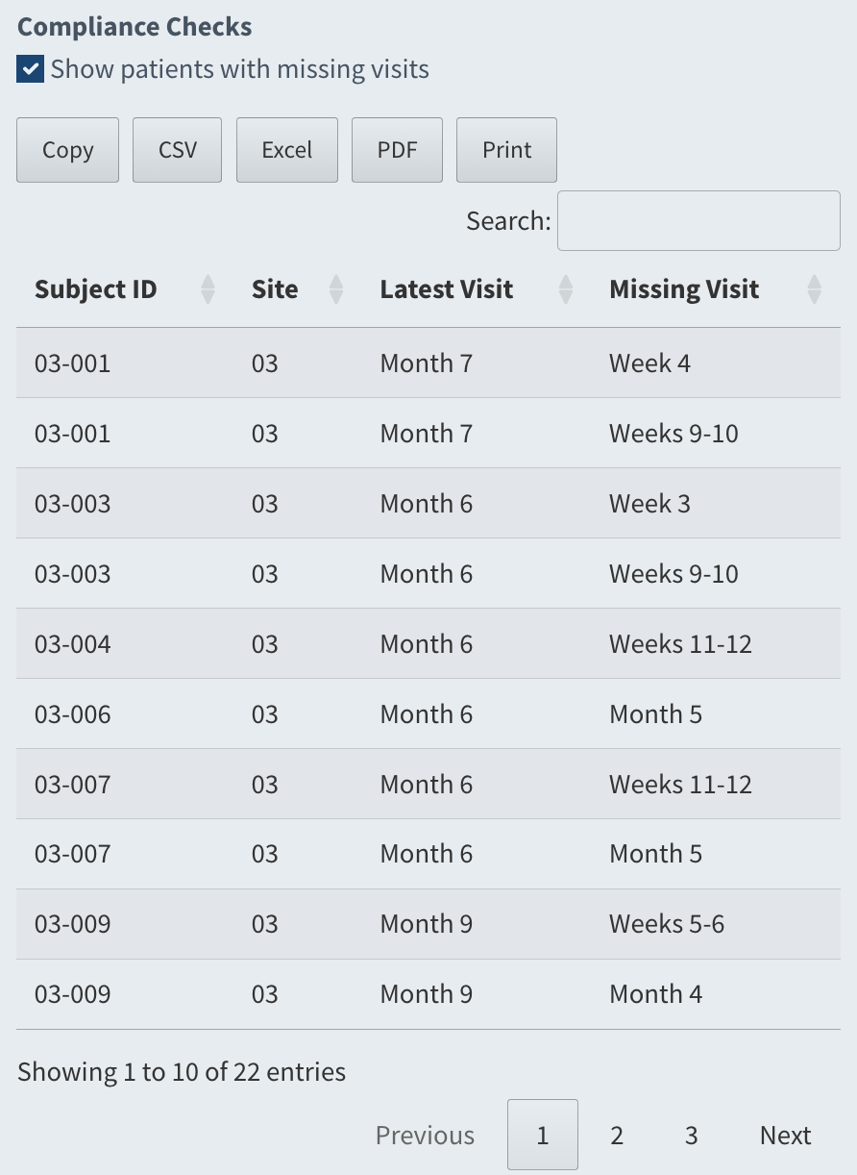
ACES-EMB clinical narrative
Compliance check
Missing visits
Visits outside expected windows
Blood draw outside expected window before biopsy
Includes the true expected date range

Slide 14
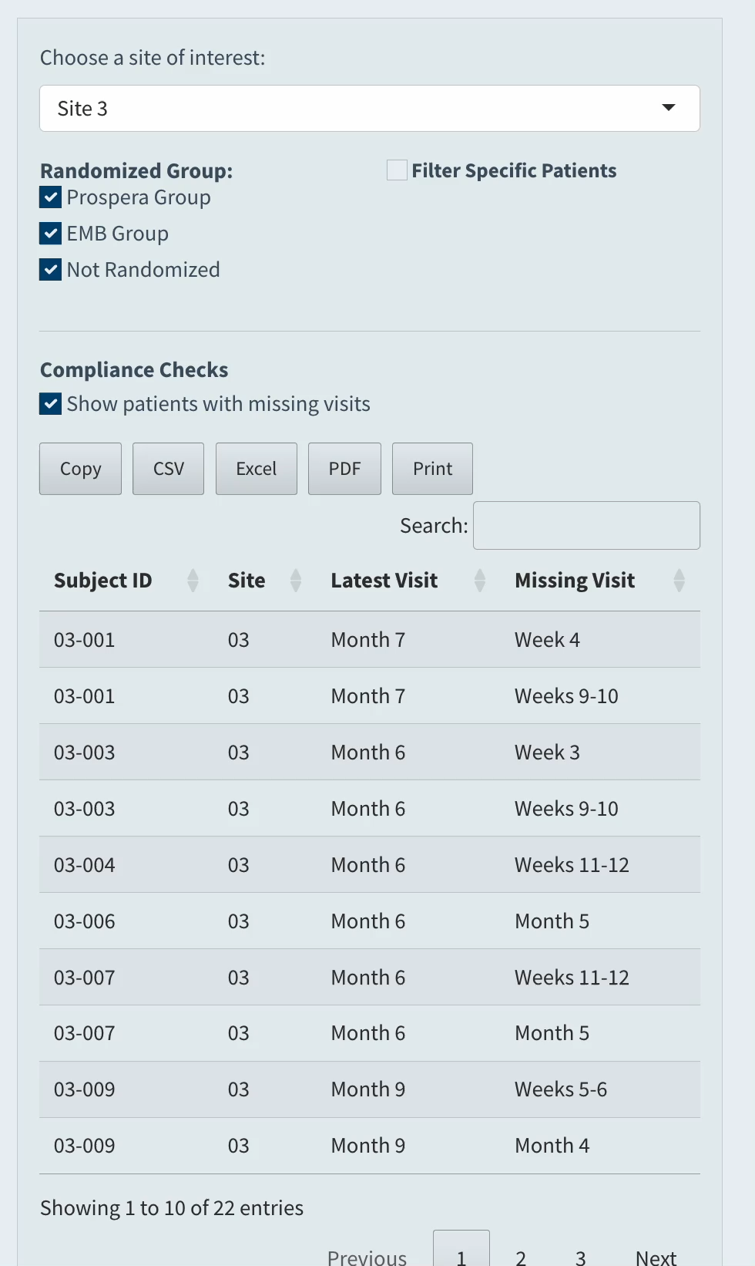
ACES-EMB clinical narrative
Compliance check
Patient filter + Compliance check

Slide 15
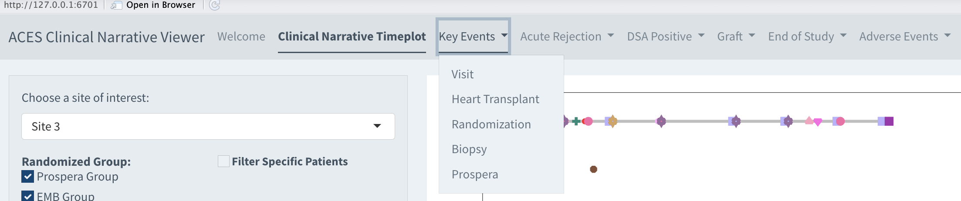
ACES-EMB clinical narrative
Menus
Key Events: Visit, Heart Transplant, Randomization, Biopsy, Prospera
Acute Rejection: ACR, AMR, Treated for Rejection
DSA Positive: Class I DSA Positive, Class II DSA Positive
Graft: Retransplant, Graft Failure
End of Study: End of Study (Except Death, Withdrawal, Pregnancy), Death, Withdrawal, Pregnancy
Adverse Event: AE Start, AE End

Slide 16

ACES-EMB clinical narrative
Timeplot– Table Interaction
Filter the event
Timeplot – table interaction for every event points

Slide 17
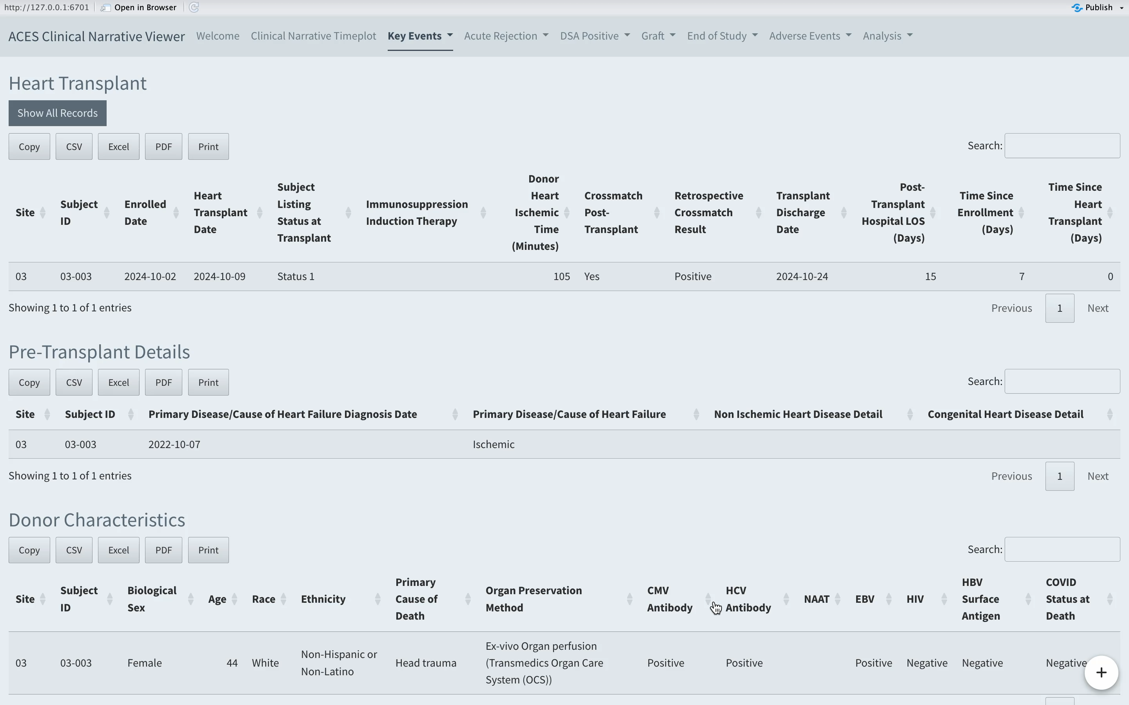
ACES-EMB clinical narrative
Tables
Show all records
Search function

Slide 18
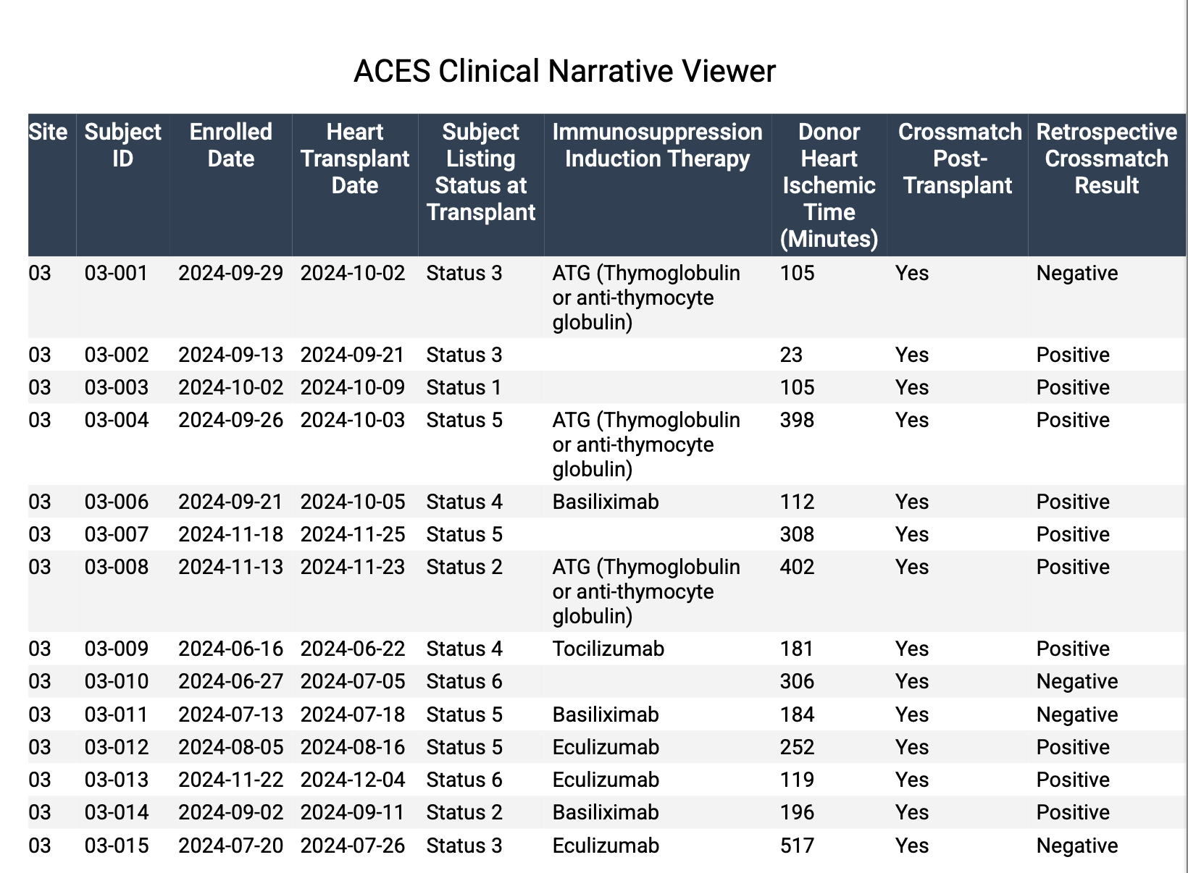
ACES-EMB clinical narrative
Tables
Download

Slide 19
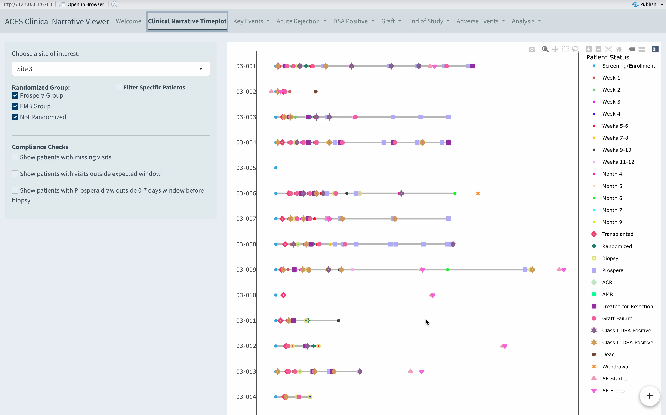
ACES-EMB clinical narrative
Analysis
Composite outcome survival curve
Outcomes: Treated rejection, Graft dysfunction, Retransplant, Death

Slide 20
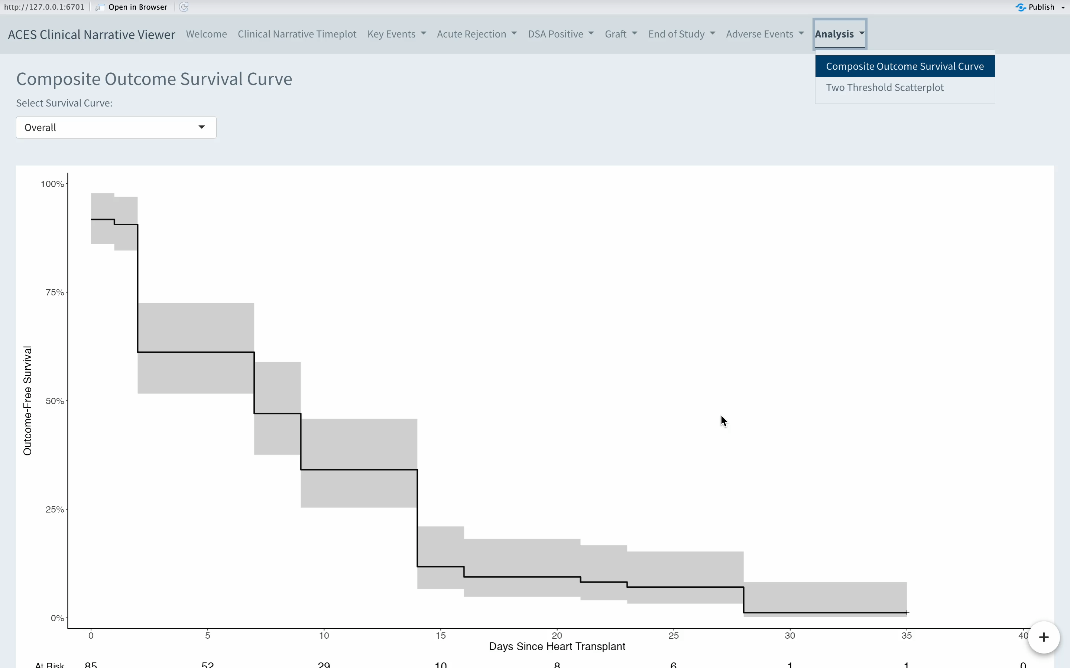
ACES-EMB clinical narrative
Analysis
Two threshold scatterplot
dd-cfDNA % vs DQS (copies/mL)
High risk: dd-cfDNA > 0.26 & DQS > 18
Notes:
dd-cfDNA Quantity Score
An atypically high quantity of cfDNA in the blood could artificially lower the measured DFE, potentially resulting in a false negative
Donor Quantification Score (DQS) is a metric describing cfDNA quantity derived from the donor, using along with DFE could mitigate the false negative risk

Slide 21




Significance of the dashboard
Track individuals visually
Check incompliance, simplify query process
Adapt to new clinical trials
Data Security
Notes:
Team members could quickly identify discrepancies or trends in the data during reviews, improving data quality and project oversight.

Slide 22

Thoughts
Time management
Communication and Collaboration
Complexity of real-world data

Slide 23
Thank you!

Slide 24
Questions?

